Slide 1
Software Quality Assurance
Er. Bipin Thapa

Slide 2
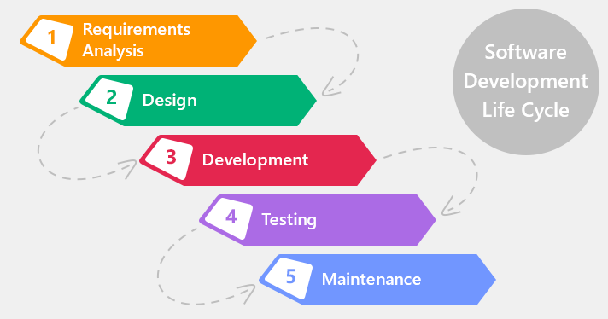
SDLC

Slide 3
Software Test Life Cycle (Software Testing Process)
It is a software test process.
Series of specific testing
Six different phases in this life cycle
Optimum level of quality is maintained.

Slide 4
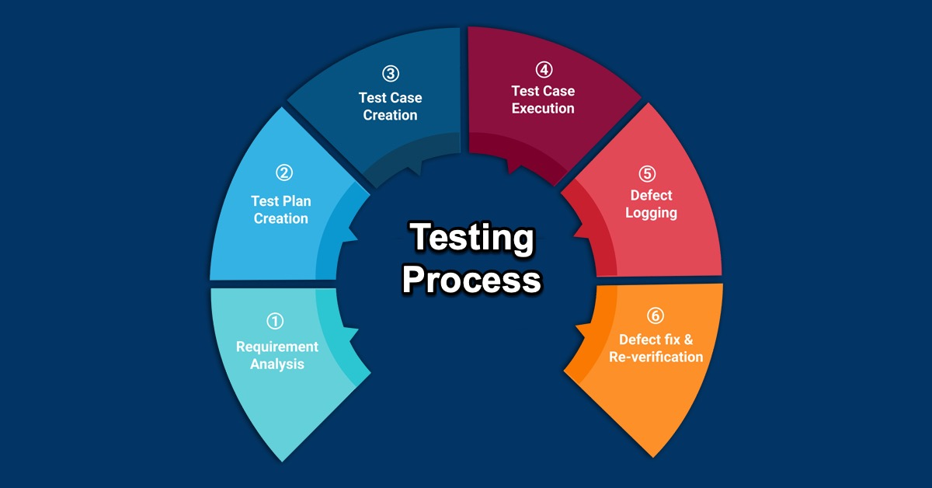

Slide 5
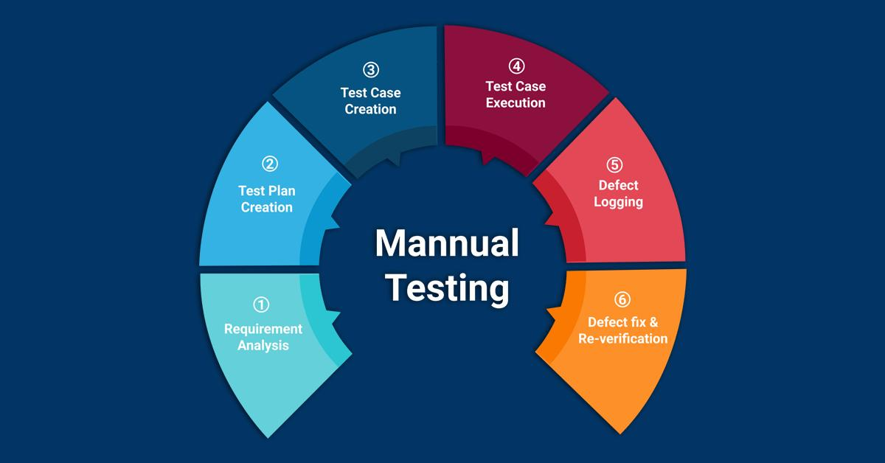
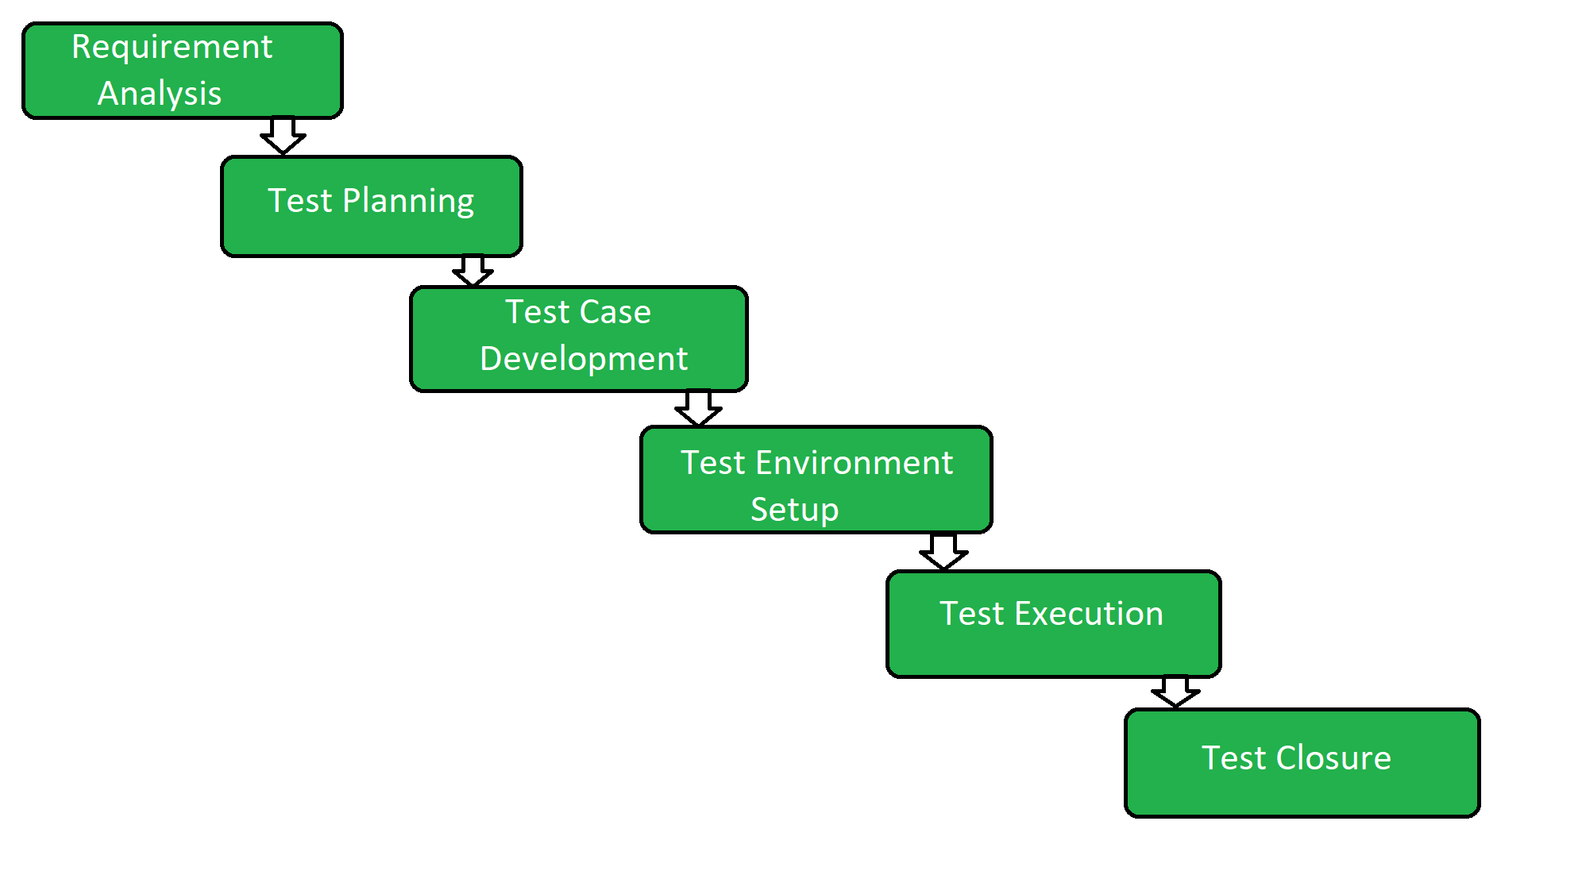

Slide 6
We go through the requirement document
We identify what is going to be made and what is to be tested.
We also discussed with PM, PO and Business Analyst for better understanding if needed.
Requirement Analysis

Slide 7
Planning the total detail effort and cost of the testing in time.
Estimation will be done.
Test planning documentation can be created if needed.
2. Test Planning

Slide 8
3. Test Case Development
Test Scenarios Test Cases are defined and created.
Prepare the Test data for testing.
Pear review the Test scenarios and test cases

Slide 9
Decides which software is tested on which server.
Test Server
Stage Server
Production Server
Usually the developer creates these testing environment.
4. Test Environment Setup

Slide 10
QA team start testing the system based on the pre written test cases.
We will also update test cases if needed.
We will add a results on it. (update it with comment or status)
Defect reports is created.
5. Test Execution

Slide 11
Once, we meet the exit criteria, We will close the test and exit from the testing cycle
Last stage of STLC.
Test Summary report is created.
6. Test Closure

